Slide 1
Maximizing Feature Extraction in DenseNet for Transfer Learning
Matt Einhorn(me263); Ayon Borthakur(ab2535)

Slide 2
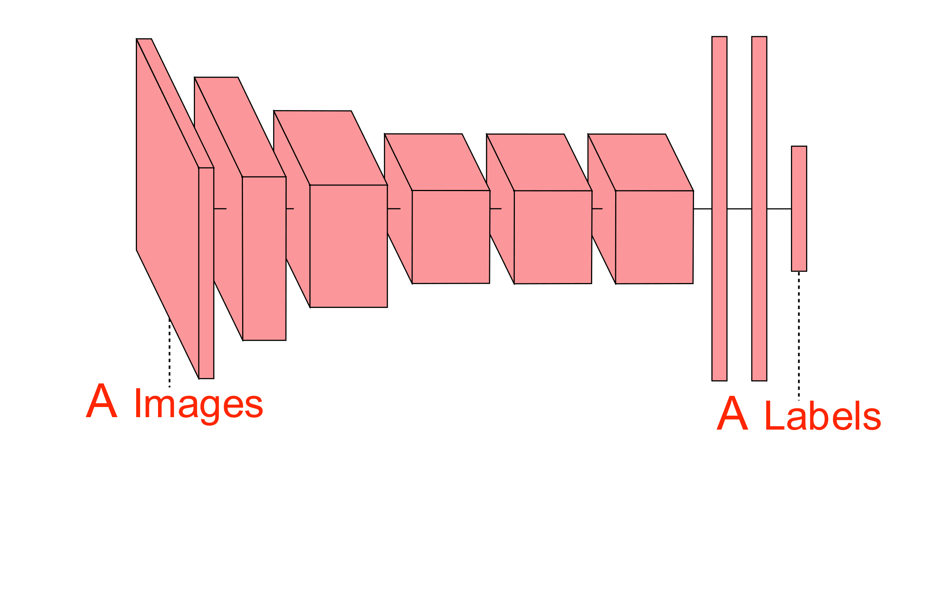
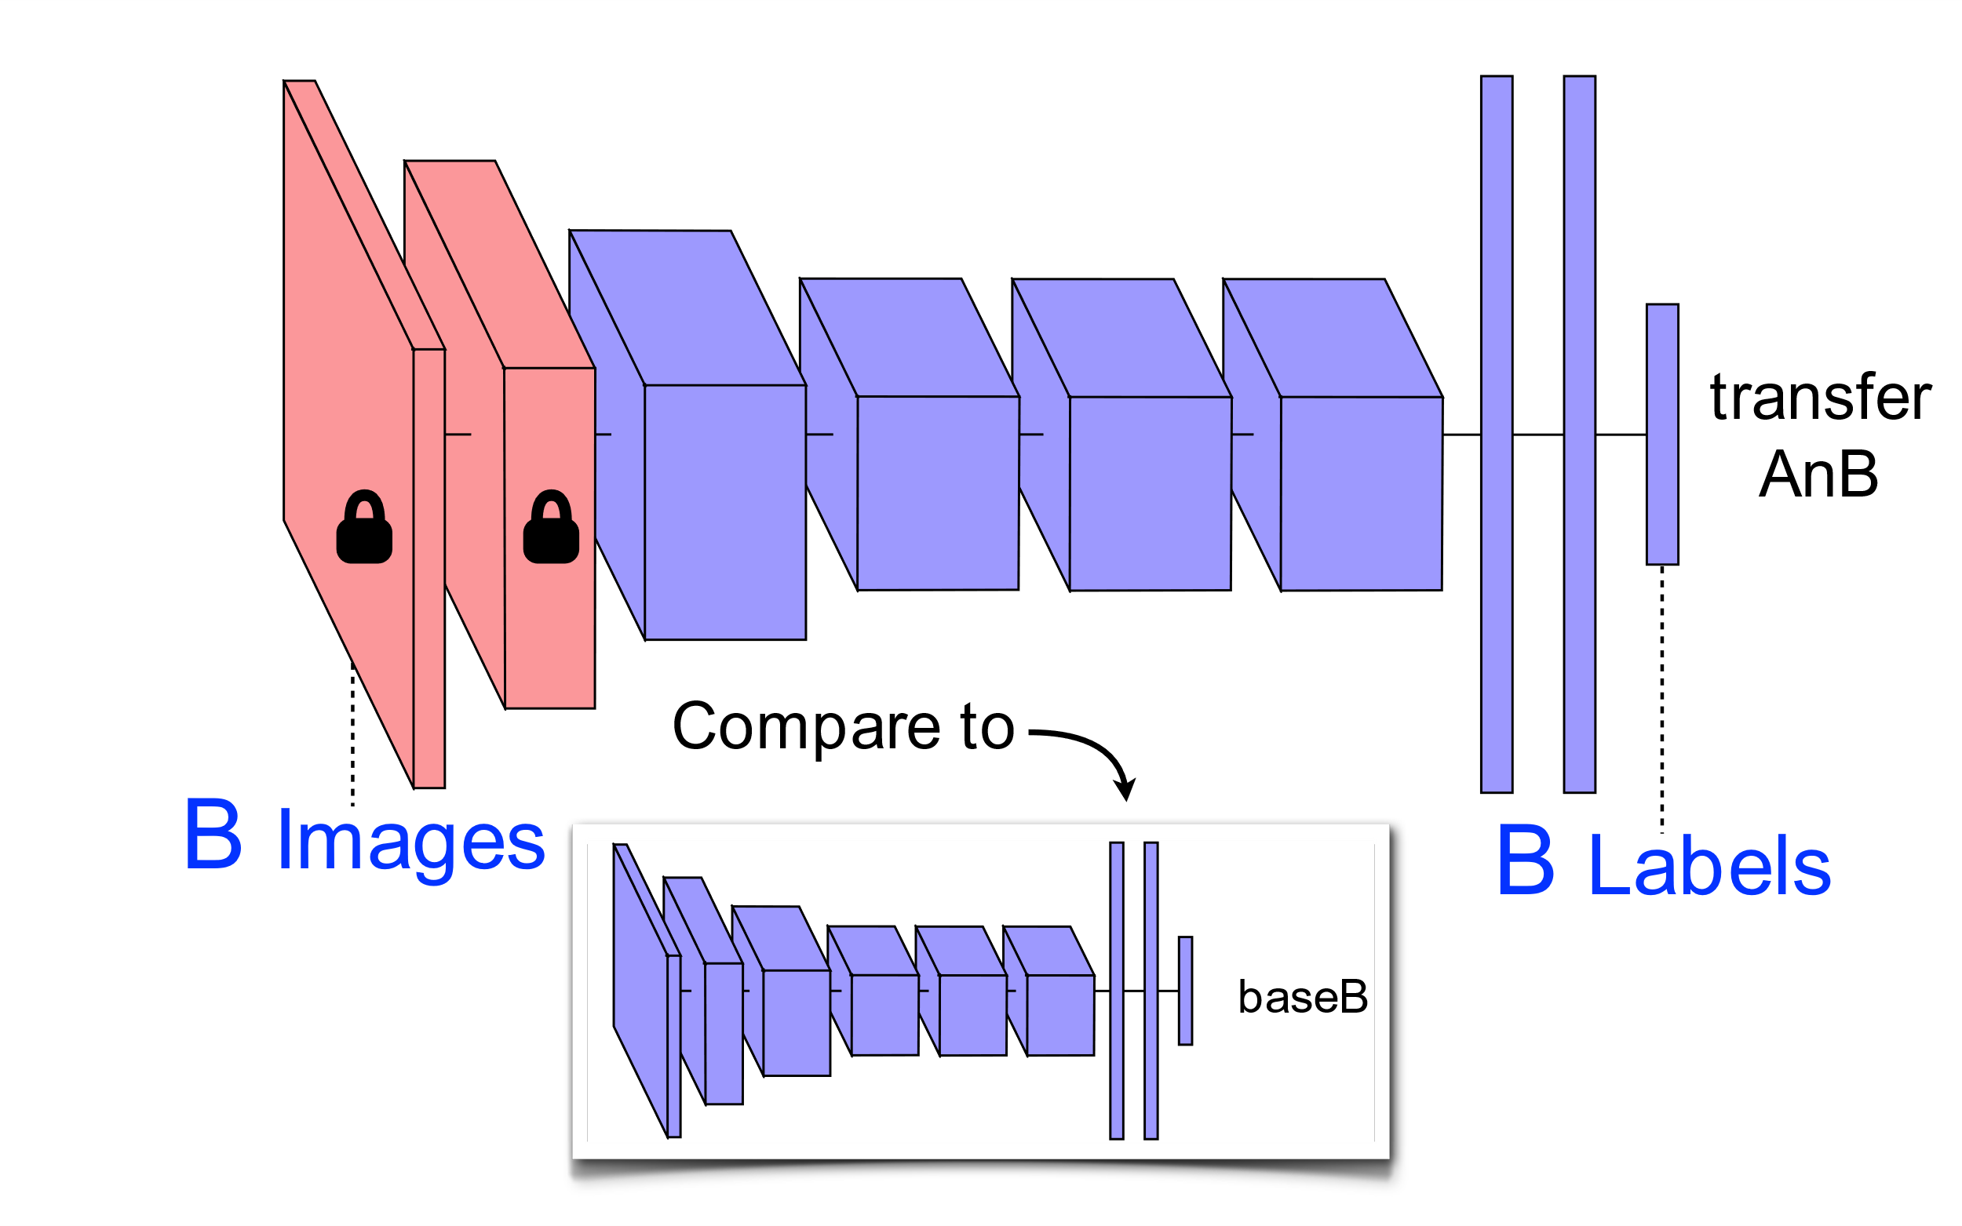
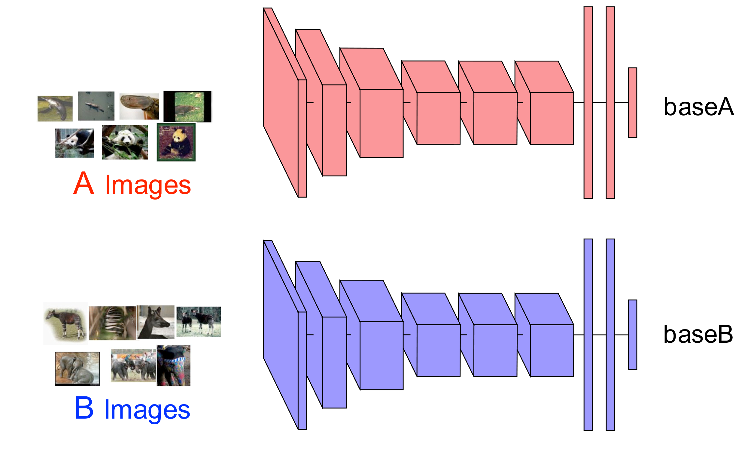
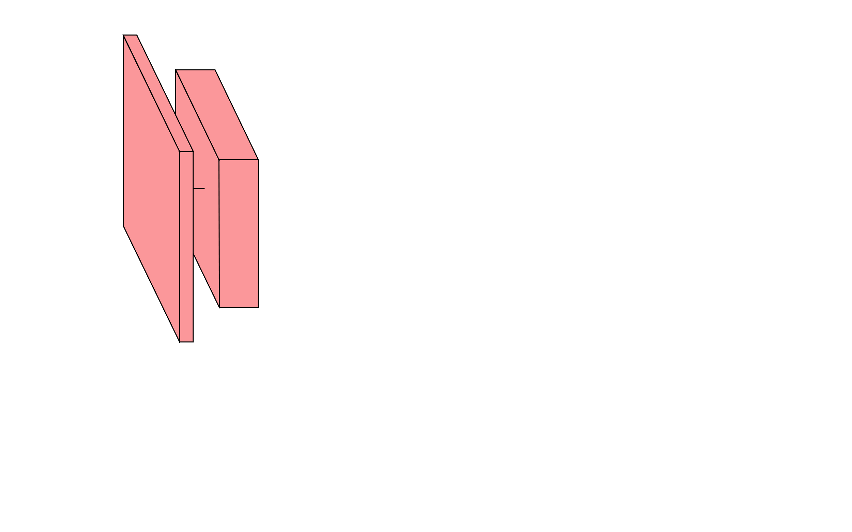
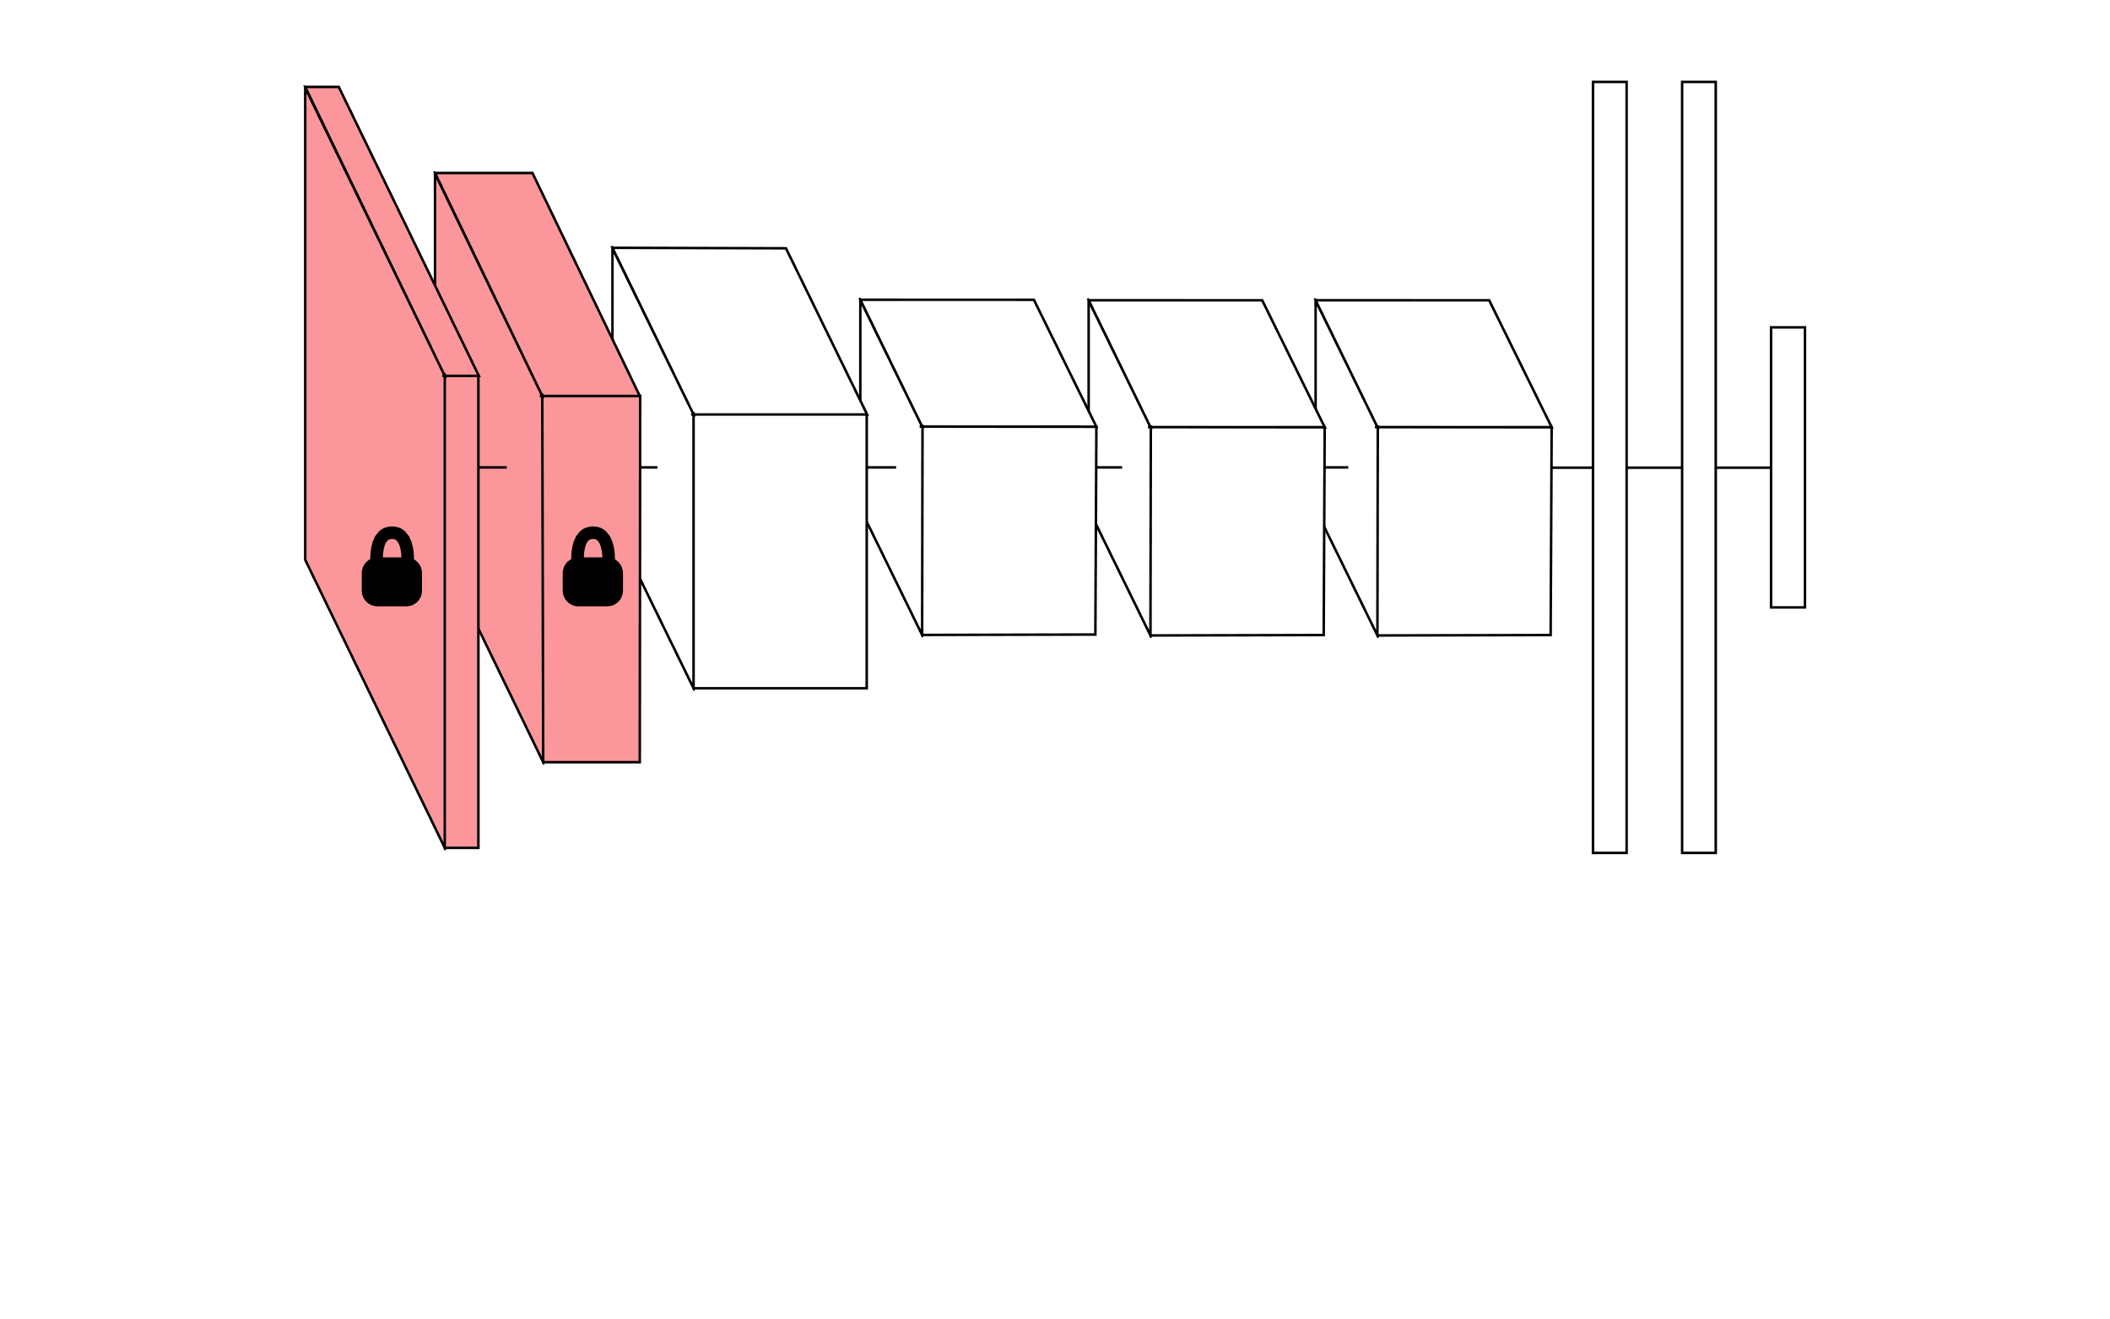
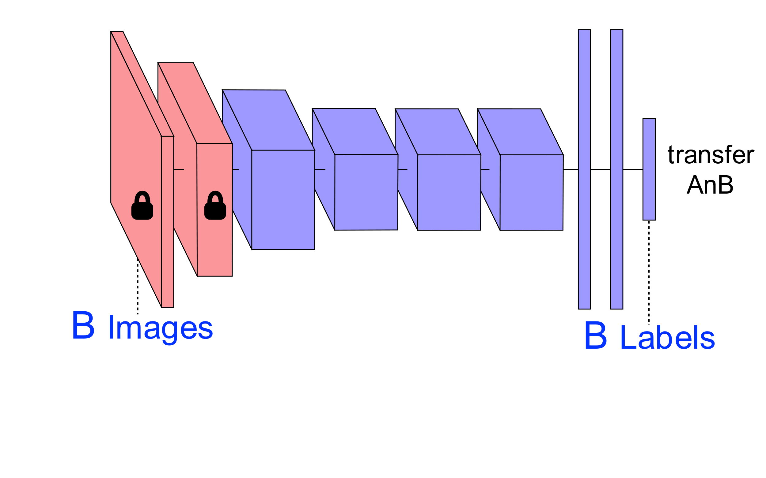
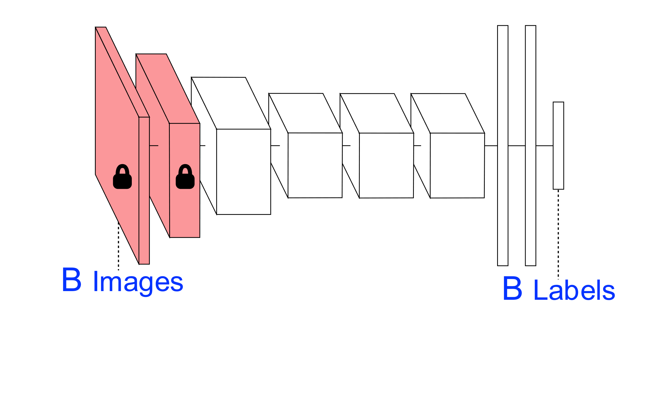
Transfer Learning approach

Slide 3
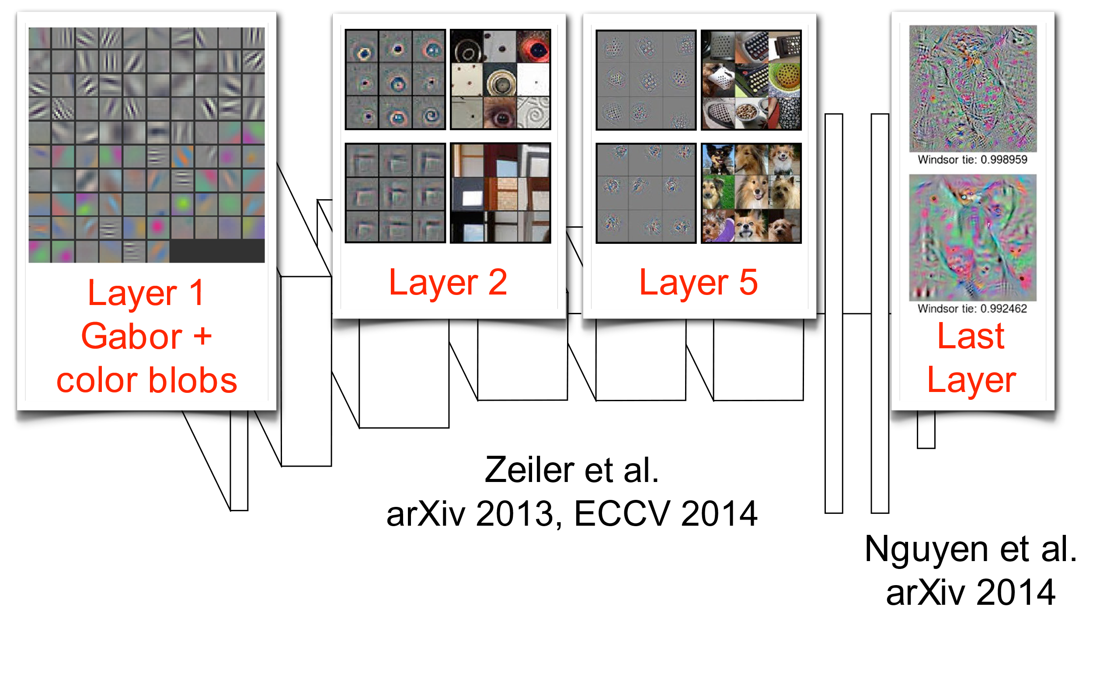
How transferable are features with depth

Slide 4
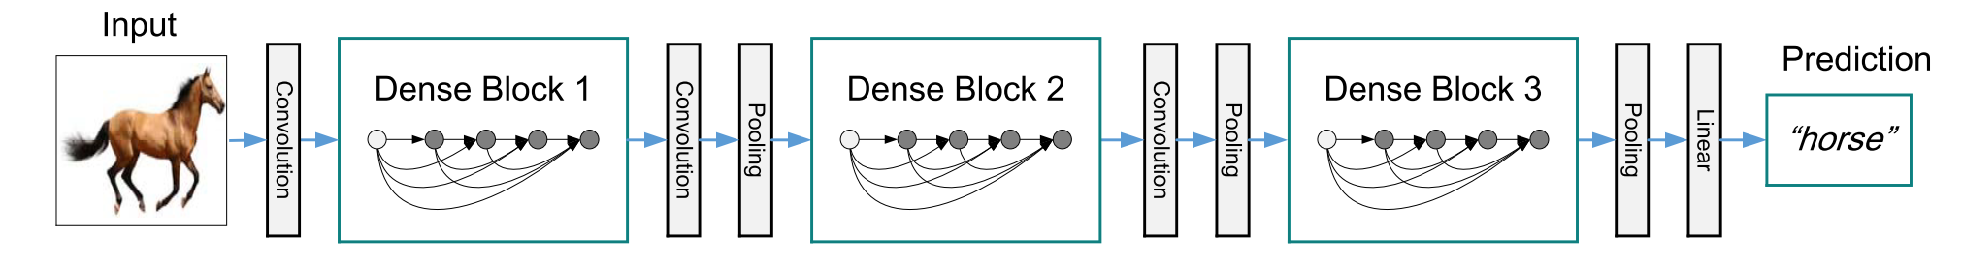
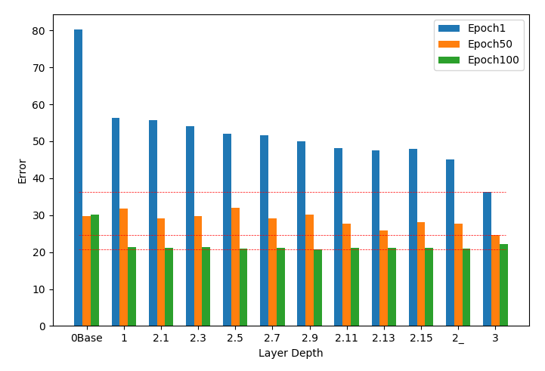
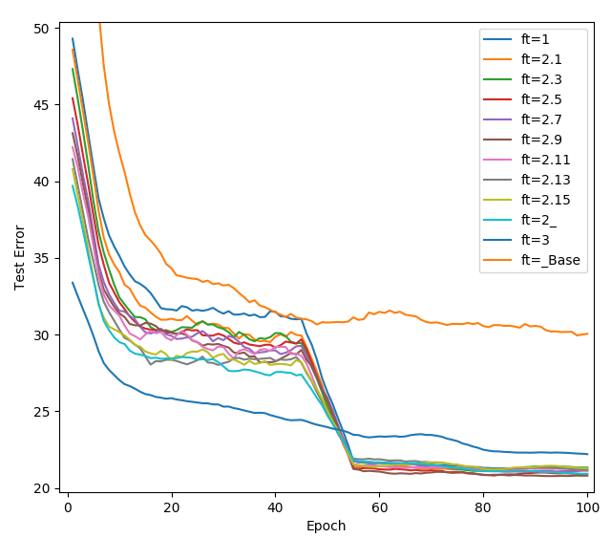
Results I
CIFAR-100
DenseNet-100-BC
50/50 random split
Natural vs unnatural split

Slide 5
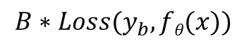
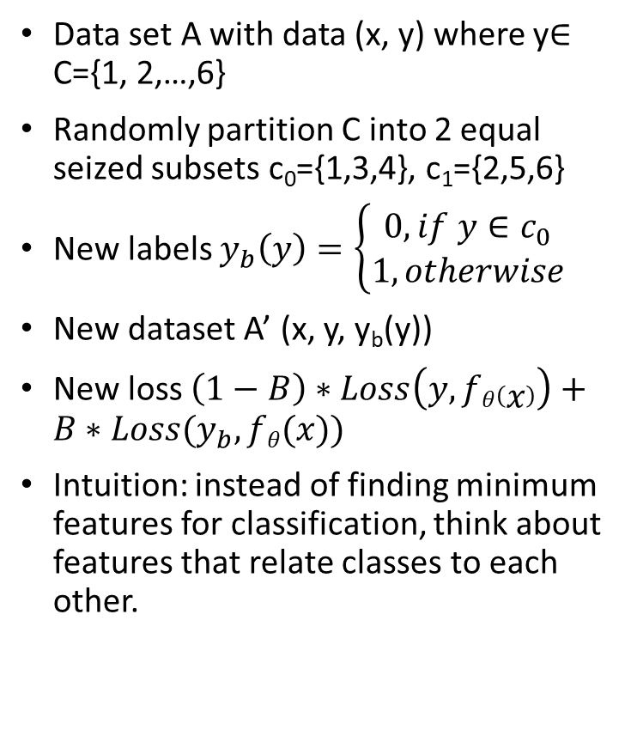
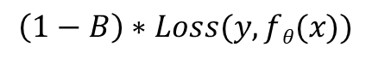
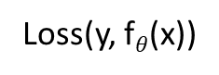
Binary Classifier
Data set A with data (x, y) where y$∈$ C={1, 2,…,6}
Randomly partition C into 2 equal seized subsets c₀={1,3,4}, c₁={2,5,6}
New labels $y_{b}\left(y\right)=\left\{\begin{aligned}0, if y∈c_{0} \\ 1, otherwise\end{aligned}\right.$
New dataset A’ (x, y, y_{b}(y))
New loss $\left(1−B\right)∗Loss\left(y, fθ\left(x\right)\right)+B∗Loss(y_{b}, fθ(x))$
Intuition: instead of finding minimum features for classification, think about features that relate classes to each other.
Loss(y, f$θ$(x))
$$\left(1−B\right)∗Loss(y, fθ(x))$$
+
$$B∗Loss(y_{b}, fθ(x))$$

Slide 6
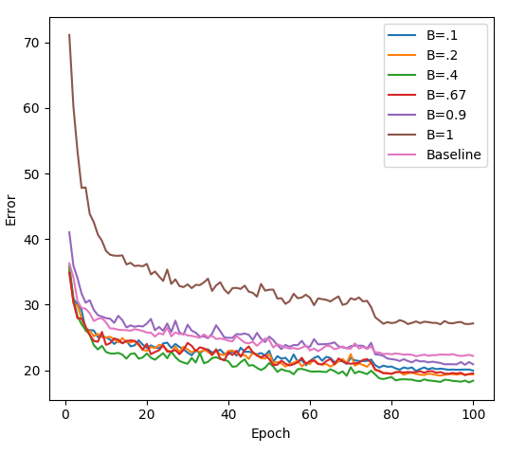
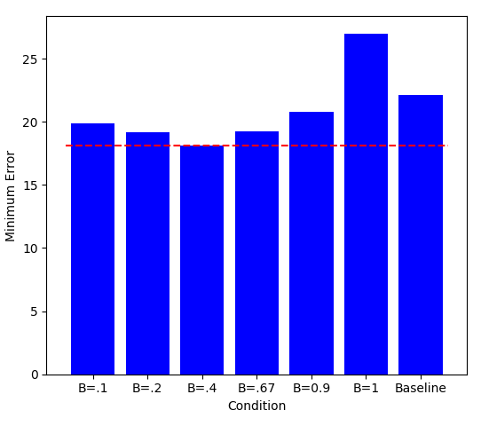
CIFAR100
Train A (50 classes), fine tune on B (50 classes)
Single binary classifier (25/25) with loss weight B + normal 50-class classifier with loss weight 1 - B
Test error - fine tuning all layers on B
Min test error - fine tuning all layers on B

Slide 7
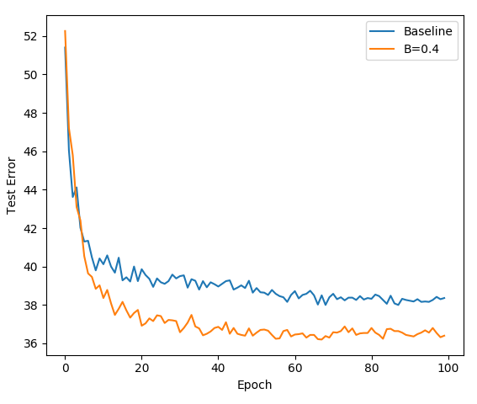
Long tail distribution
Reduce dataset B by 10 (600/class -> 60/class)
Fine tune Network A on B

Slide 8
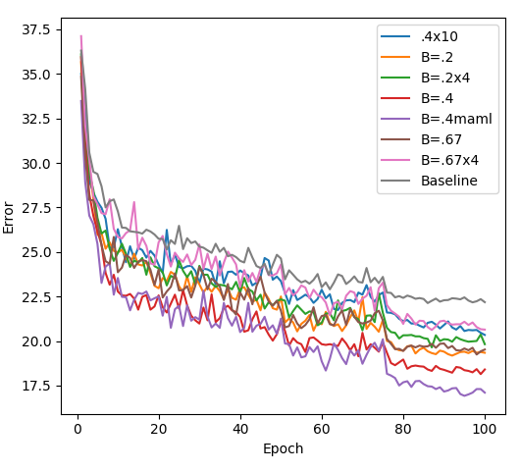
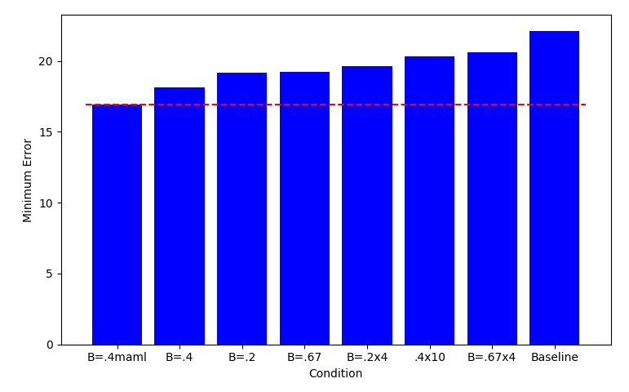
CIFAR100
Train A (50 classes), fine tune on B (50 classes)
1-10 binary classifiers with loss weight B + normal 50-class classifier with loss weight 1 - B

Slide 9
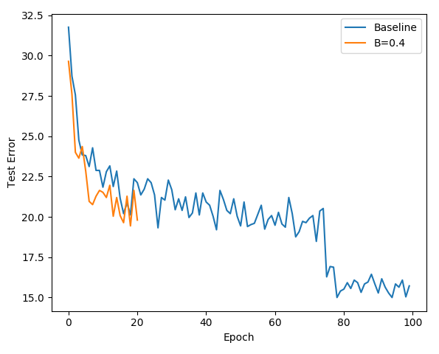
Future work
Ebird/imagenet
Investigate images that the Binary classifier trained network does better
Look at softmax output for those images
Replications
Initial ImageNet100 results

